Slide 1

LJMU MSDS/ML C31

Slide 2


Course: MSDS/ML
Live Session On: Research Frontiers in Deep Learning: Architectures, Training and Research Questions
Instructor: Dr. Jyoti Dabass
Deep Learning: Architectures, Training and Research Questions

Slide 3

Frontier Map: What Counts as a Deep-Learning Research Question?

Slide 4
Welcome and Opening Hook
76% → 80%
Same ResNet-50. Only the training recipe changed.
When a paper says “new architecture wins”, what actually won?
Papers: arxiv.org/abs/2110.00476

Slide 5

What You Will Be Able to Do Today
1
Turn an idea into a testable research question
2
Compare architectures by their assumptions
3
Read training curves and diagnose them
4
Plan a fair experiment, then decide: proceed, redesign or park
Your assignment is a research brief. Every part fills one box of it.

Slide 6



How We Will Work Today
Do, not just listen
Read real papers
Two real breaks
Ask freely
Polls, MCQs, a live curve-reading round and a design lab
Figures from the papers, plus 2026 work. Links at the bottom of each slide
10 minutes, about every hour
Type Q in the chat. I read them at checkpoints
Every slide is about a minute. If you want me to slow down, say so.

Slide 7
Research Question or Implementation Task? (Poll)
Type R (research) or I (implementation)
Fine-tune ResNet-50 on our photos to reach 95%.
1
Do residual connections allow a higher stable learning rate? Same data, same steps.
2
Use a Transformer because it is state of the art.
3
Does LoRA match full fine-tuning on 2,000 examples at equal tuning?
4
Go with your gut.

Slide 8

Poll Result: Sorting the Four Statements
2 and 4 are research
One thing changed · something held fixed · the result could fail

Slide 9




The Four-Part Test
Task
Limitation
Intervention
Evidence
What are we solving?
What fails today?
The one thing we change
What result would convince us?
A new block, a deeper net, a bigger model: not a contribution by itself

Slide 10



Three Questions for the Whole Session
What changed?
What was held fixed?
What would change your mind?
Say it exactly
Data, compute, tuning
The evidence you accept
If you can answer all three, you are doing research

Slide 11


Part 1 Recap: Box for Your Brief
One line to remember
Box for your brief
A research question names the task, the limitation, the one change and the evidence
Your research question in four parts
Next: architectures as bets

Slide 12

Architecture Families and Inductive Bias

Slide 13

What Is Inductive Bias?
A bet about the data
No model learns everything from finite data, so each one assumes some structure

Slide 14
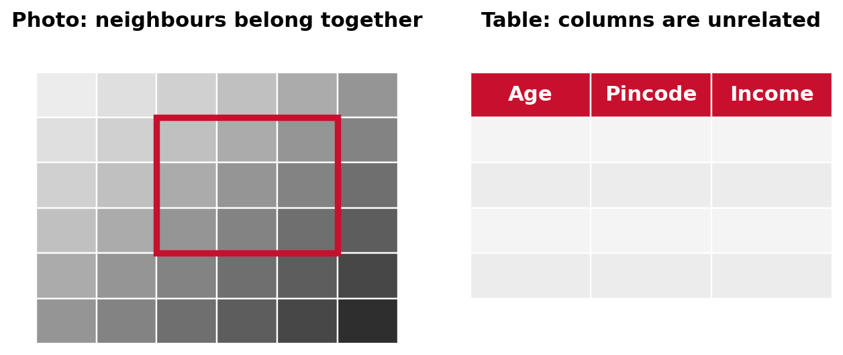
Match or Mismatch
When you pick an architecture, you are picking a bet

Slide 15
Five Architecture Families, One Comparison
Family | Bets on | Information flow | Cost
MLP | Almost nothing | Every input to every output | Data-hungry
CNN | Locality, repeated patterns | Local; grows with depth | Efficient; long range is slow
RNN / LSTM | Order, a running summary | Step by step | Sequential training
Transformer | Little about layout | Every token sees every token | Grows with length squared
GNN | Relationships matter | Along the edges | Depends on graph size
Newer: state space models, linear in length

Slide 16
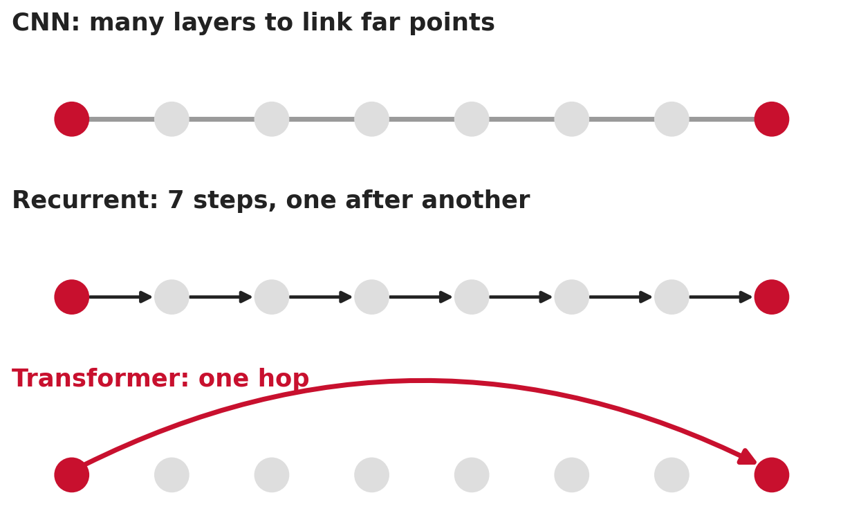
Information Flow: How Far Can a Signal Travel?
Path length shapes what a model can learn

Slide 17



Computational Profile: What Each One Costs
Training speed
Memory
At inference
CNN and Transformer run in parallel. Recurrent steps wait in line.
Transformer memory grows with length squared
Recurrent and state-space models keep a small, fixed state
Pick the family whose cost matches your constraint

Slide 18
Match the Problem to the Architecture (Activity)
Type a family + one assumption (problems 1 and 2)
28×28 digit images, 5,000 samples, one small GPU
1
Predict a molecule’s property from atoms and bonds
2
About 40 seconds each.

Slide 19
Match the Problem to the Architecture (Activity): Problems 3 and 4
Same task: a family + one assumption
100 sensor readings in time order, 20,000 recordings, predict a fault
1
Legal documents of about 8,000 words
2
Pick by assumption, not popularity.

Slide 20

Reading the Answers
Pick by assumption
One and two are clean. Three is a real debate. Four hides a catch.

Slide 21


A Bias Is a Hypothesis, Not a Verdict
Vision Transformer
A ConvNet for the 2020s
Mid-size data: a few points behind ResNets. Large pretraining: ahead.
A ResNet given modern training and design choices matched Transformers.
Depends on data scale
The recipe matters
Name the bet and the data regime where it holds
Papers: arxiv.org/abs/2010.11929 · arxiv.org/abs/2201.03545

Slide 22
Part 2 Recap: Box for Your Brief
One line to remember
Box for your brief
Every architecture is a bet. Name the bet and the data regime.
The architecture you use or modify, and its assumption
Next: Transformers, in detail

Slide 23

Transformers, Attention and Representation Design

Slide 24


Attention in Plain Words
Query
Key
Value
What am I looking for?
What do I contain?
What I hand over if you pick me
Scores → weights that sum to one → a weighted mix of values
Papers: arxiv.org/abs/1706.03762

Slide 25
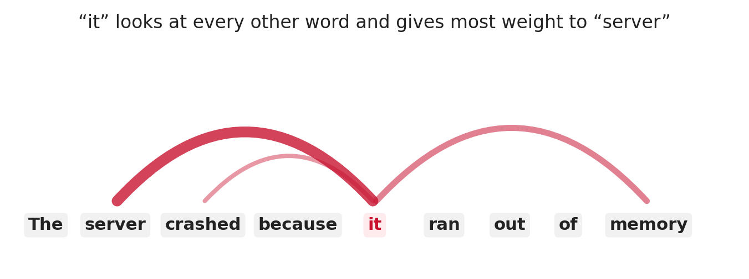
Attention in Plain Words: An Example
The weights tell the model what to read

Slide 26
Heads: Many Views in Parallel
Several attention heads
Each head can pick up a different pattern, run side by side

Slide 27
An Attention Map Is Not an Explanation
Heat map ≠ reason
People have changed attention weights a lot without changing the output

Slide 28
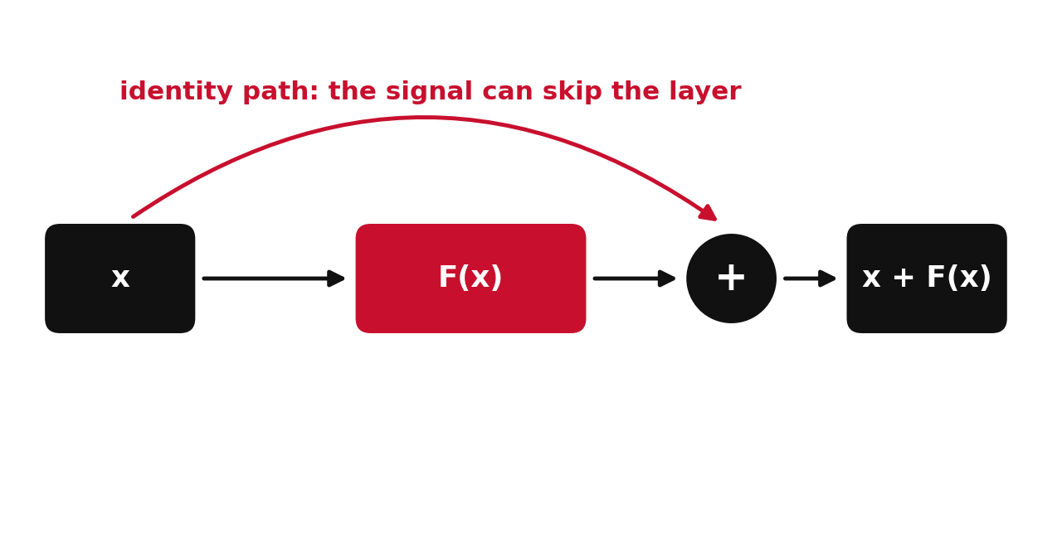
Residual Connections: Why Depth Became Trainable
Plain 56-layer net: worse training error than 20 layers
Papers: arxiv.org/abs/1512.03385

Slide 29


Normalisation: Pre-LN or Post-LN?
Post-LN
Pre-LN
Normalise after the residual add. The original Transformer.
Normalise before. Usually stabler at higher learning rates.
We will test exactly this in the design lab

Slide 30
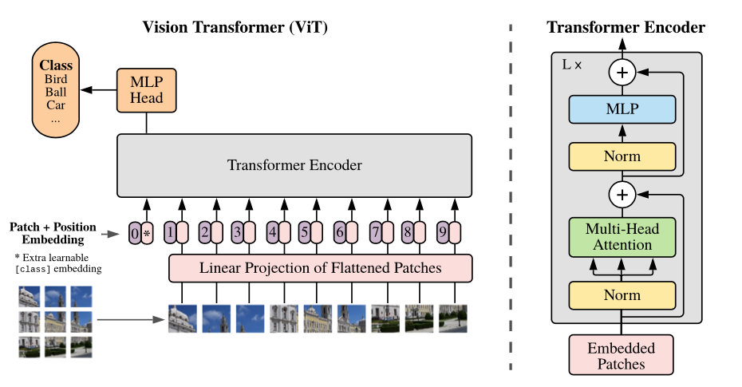
Normalisation in a Real Figure
Dosovitskiy et al. 2020 · github.com/google-research/vision_transformer
Spot where Norm sits: before attention and before the MLP
Papers: arxiv.org/abs/2010.11929

Slide 31


Position: Attention Alone Ignores Order
Sine waves
Learned
Relative
Rotary
The original, fixed
A vector per position
Distance between tokens
Common in large models
Shuffle the tokens and plain attention does not notice

Slide 32
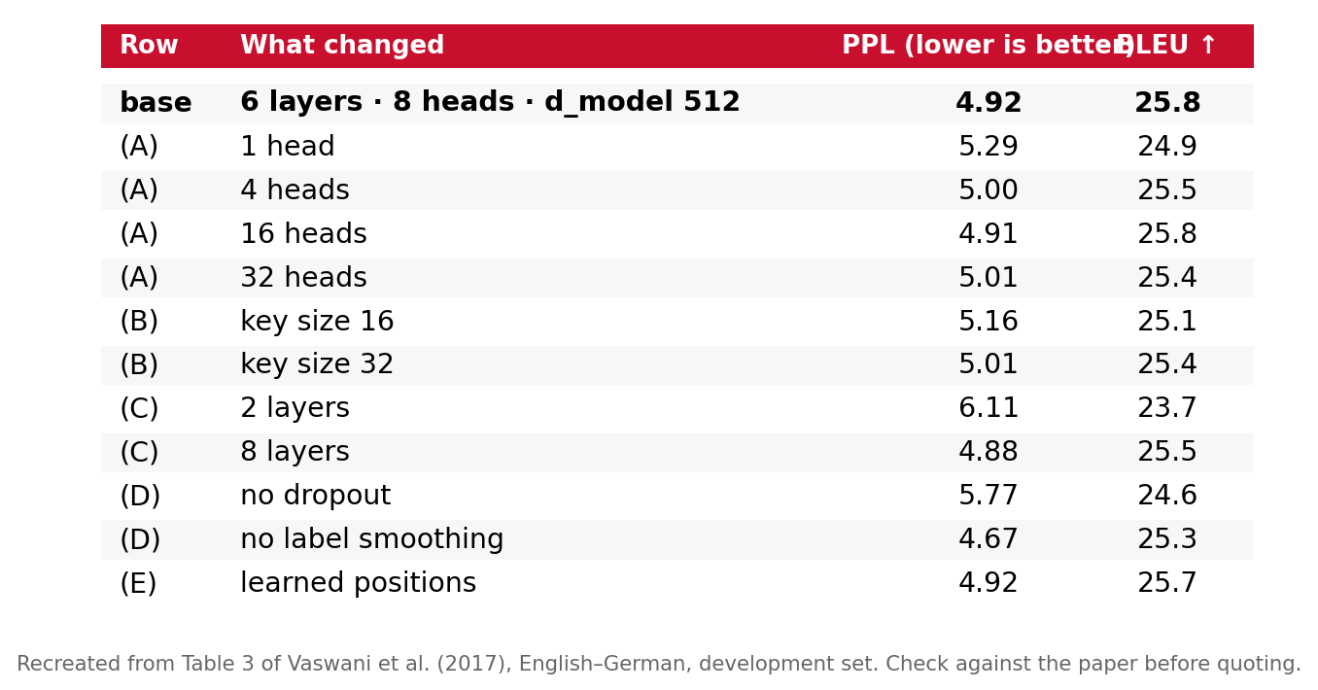
Live Paper Analysis: The Transformer Ablation Table
Recreated from Table 3, Vaswani et al. 2017 · arxiv.org/abs/1706.03762
Find: a row that matters · a row that barely matters · what is missing
Papers: arxiv.org/abs/1706.03762

Slide 33

Live Paper Analysis: What We Found
Heads
Position
Missing
One head is clearly worse. Too many also hurt.
Learned ≈ sine waves. A useful negative result.
Spread across seeds? Learning rate retuned per row?
Ablation = a question, not a checklist

Slide 34

An Ablation Is a Question, Not a Checklist
Remove one part, ask why
Which part do you believe is necessary, and why? Design the test that shows it.

Slide 35



Representation Design as a Research Lever
Text
Images
Tables
Time series
Tokenisation
Patch size
Category encoding
Windowing and scaling
Name one intervention, exactly

Slide 36
From Design Change to Hypothesis
Design change | Prediction | Evidence
Residual connections | A deeper net reaches lower training error | Training error at several depths
Pre-LN | Higher stable learning rate | Range of rates without divergence
Learned positions | Better on longer sequences | Accuracy beyond training length
Each one: a change, a prediction, a way to be wrong

Slide 37
MCQ 1: What Does a Negative Ablation Tell You?
Learned position encodings barely change the score versus sine waves. What does that suggest?
A
Learned positions are broken
B
In that setup, the position encoding was not a main driver of quality
C
Attention no longer needs any position information
D
The experiment must be wrong

Slide 38
MCQ 1 — Answer
Correct answer: B
In that setup, the position encoding was not a main driver of quality
Why
Both versions carry position information. The swap just did not move the result. One setup and one run cannot prove it in general.
Discuss: why are the other options wrong?

Slide 39
Part 3 Recap: Box for Your Brief
One line to remember
Box for your brief
One intervention, named exactly, so the result traces back to it
Your intervention and the ablation that isolates it
Next: making models bigger

Slide 40

Scaling Architectures: Depth, Sparsity, Mixture-of-Experts and Long Context

Slide 41


Four Ways to Grow
Deeper
Wider
Sparser
Longer
More layers
Bigger hidden size
More parameters, few used per token
Longer input
Always ask: which resource grew?

Slide 42
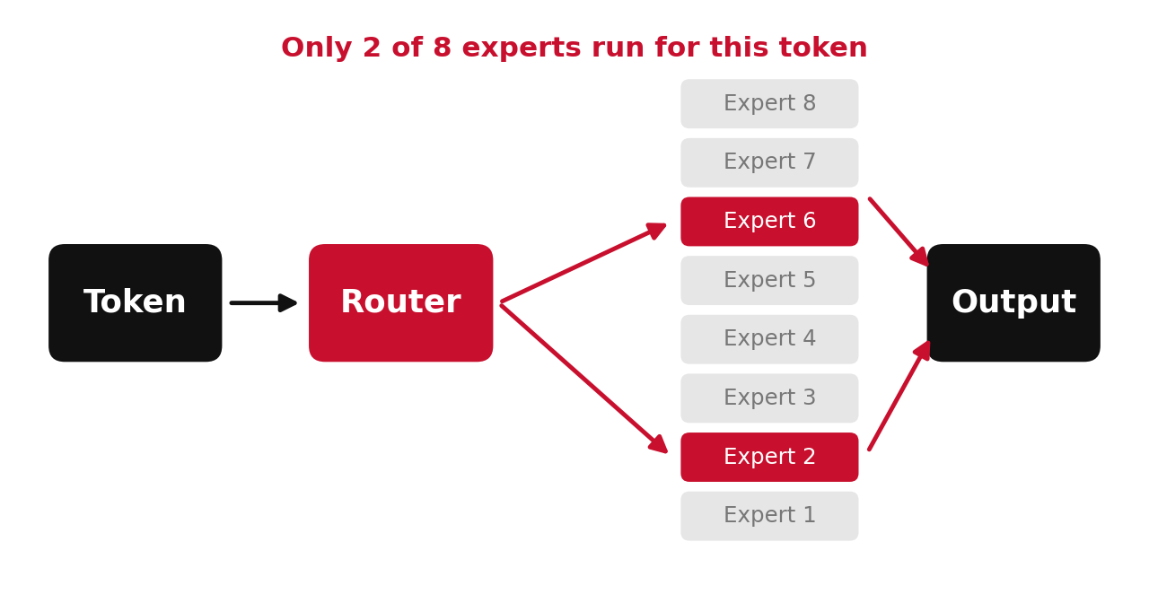
Mixture-of-Experts in Plain Words
A router sends each token to a few experts

Slide 43


Total vs Active Parameters
Total
Active
In memory
Mixtral 8x7B: about 47 billion
About 13 billion used per token
All experts must still be loaded
Report both numbers, or the comparison is not fair
Papers: arxiv.org/abs/2401.04088

Slide 44
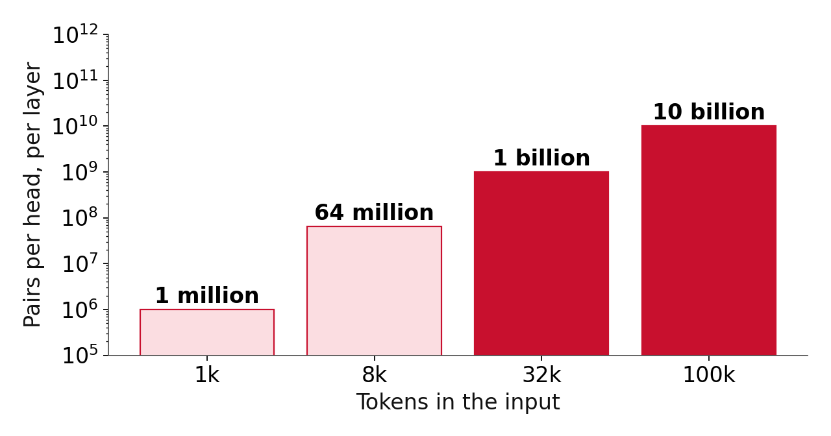
Long Context: The Pair Count Explodes
Doubling the length roughly quadruples attention cost

Slide 45


Cheaper Attention, Fewer Pairs, or Fixed State
FlashAttention
Sparse or window
State space / linear
Same exact attention, far less memory traffic
Look at fewer pairs
A fixed-size running state
Still quadratic compute
Approximation
Linear in length
Three families of answers to the same cost problem

Slide 46
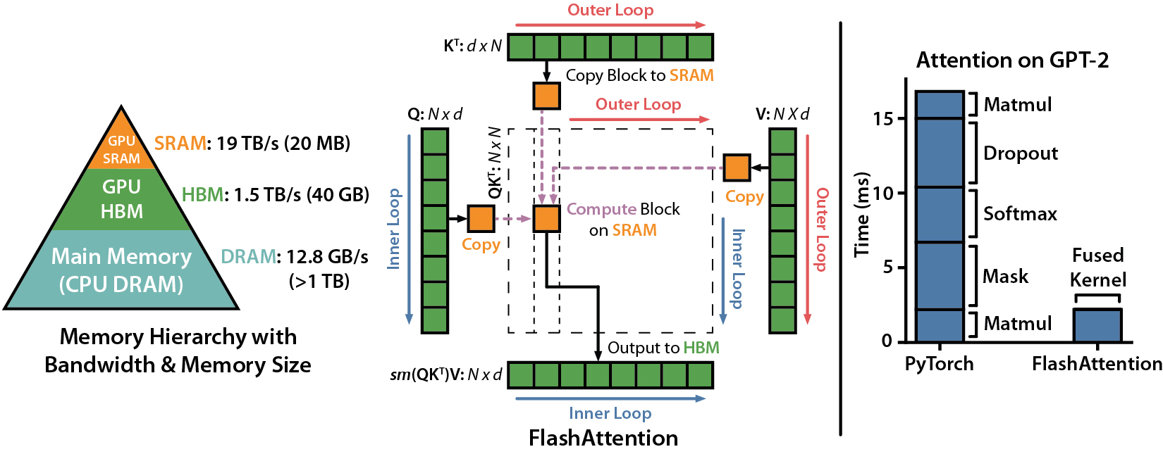
FlashAttention: Same Maths, Smarter Memory
Dao et al. 2022 · github.com/Dao-AILab/flash-attention
Exact attention, far fewer trips to slow memory
Papers: arxiv.org/abs/2205.14135

Slide 47
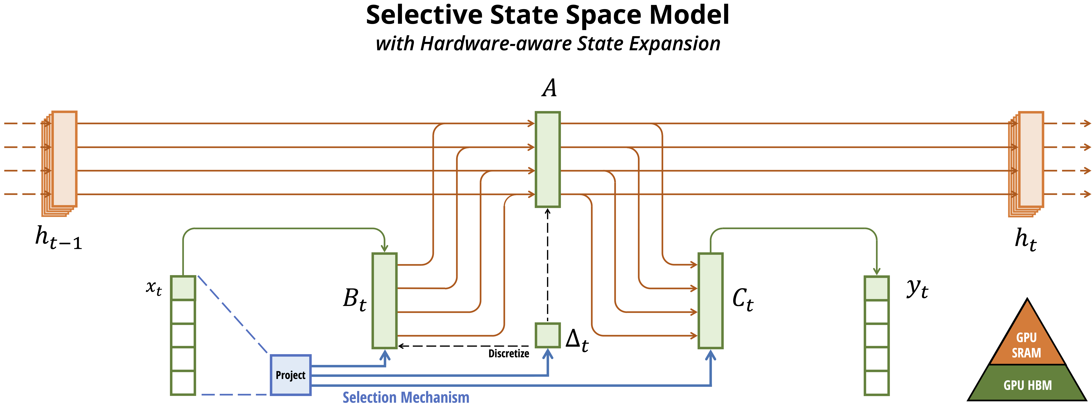
State Space Models: A Fixed-Size State
Gu and Dao 2023 · github.com/state-spaces/mamba
Cost grows in a straight line with length
Papers: arxiv.org/abs/2312.00752

Slide 48

Accepts Is Not Uses
100k tokens in ≠ 100k used well
Models often use the start and end of a long input better than the middle
Papers: arxiv.org/abs/2307.03172

Slide 49
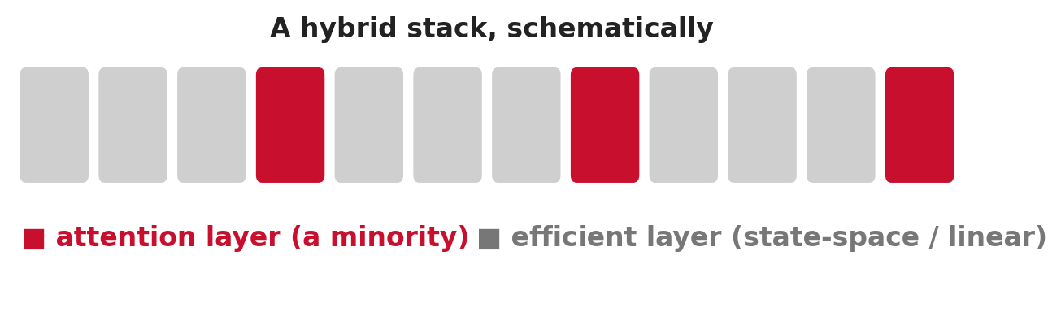
2026 Update: What a Hybrid Looks Like
Mostly efficient layers, a minority of attention layers

Slide 50
2026 Update: Hybrids Take Over Long Context
Alternate the layers
In the wild
Why now
Mostly efficient layers, a minority of attention layers
NVIDIA Nemotron 3 mixes attention with Mamba-2. Qwen3.6 uses Gated DeltaNet layers.
Agents push models to ever longer contexts
Pure state space did not win. Hybrids did.
Papers: arxiv.org/abs/2605.08301 · magazine.sebastianraschka.com/p/llm-research-papers-2026-part1

Slide 51
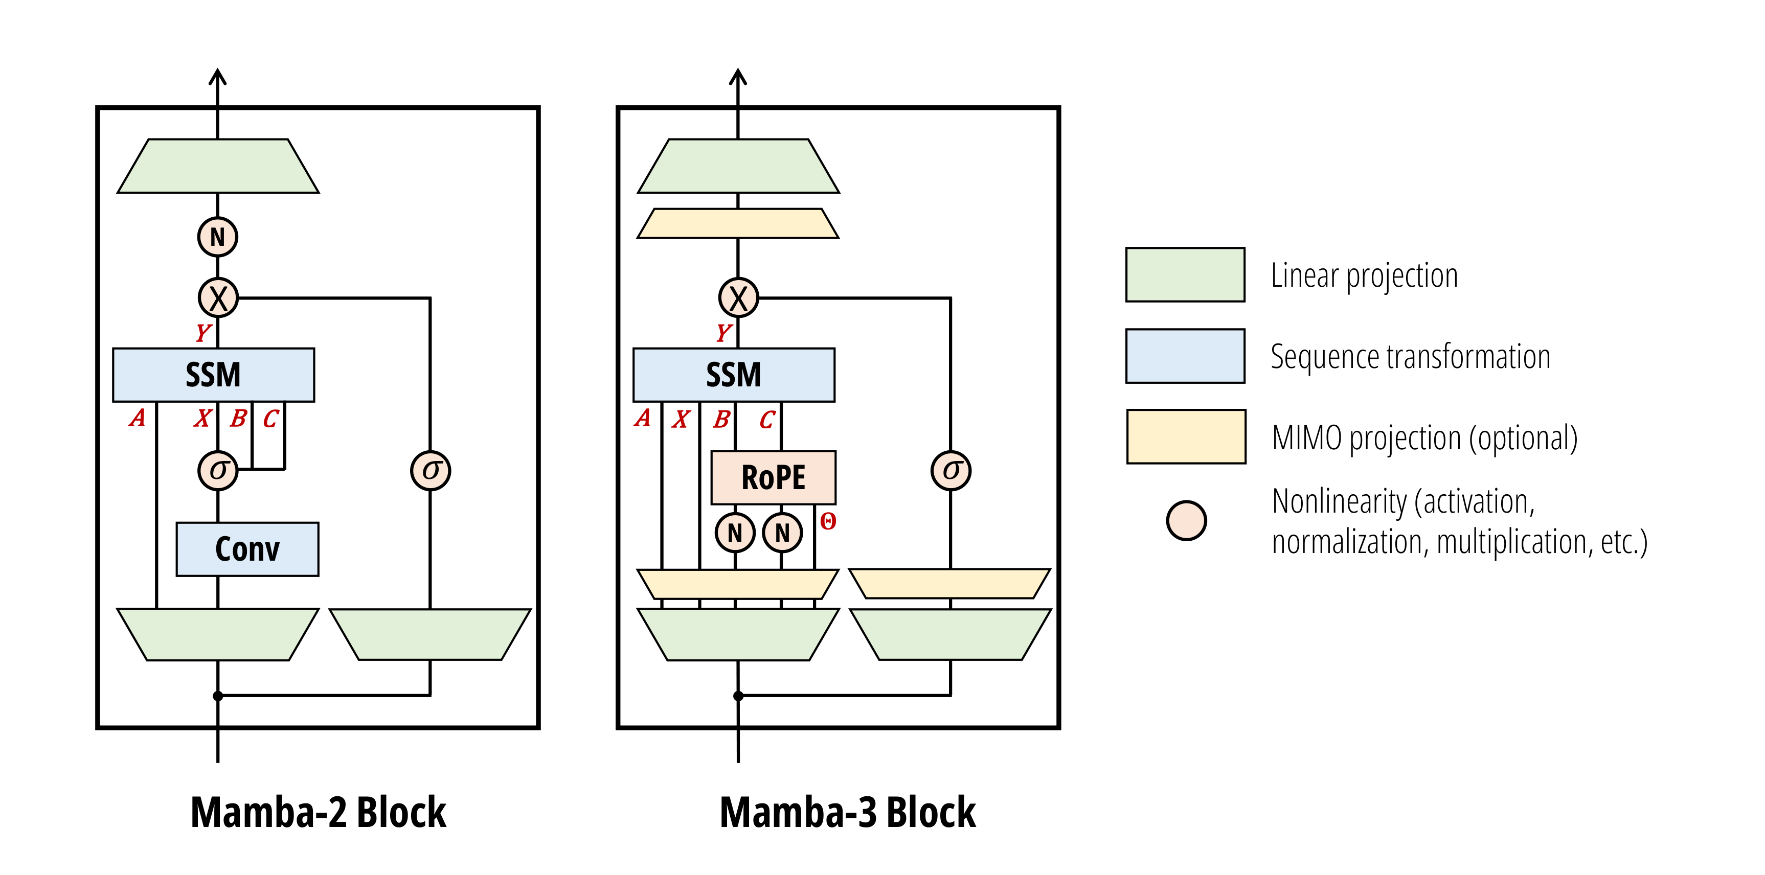
2026 Update: The Mamba-3 Block
Mamba-2 and Mamba-3 blocks · github.com/state-spaces/mamba
The block design keeps evolving
Papers: github.com/state-spaces/mamba

Slide 52
2026 Update: A Controlled Hybrid Study
Priming: Hybrid State Space Models From Pre-trained Transformers
Converts pretrained Transformers into hybrids
Compares state-space layer types at scale
2026
Same conditions, one thing changed
arxiv.org/abs/2605.08301

Slide 53

2026 Update: What Is Still Open for Hybrids
Independent tests
Matched baselines
Student-scale study
Most long-context claims come from the labs that made the model
Hybrid vs attention + retrieval, at equal cost?
Tens of millions of parameters, a long-range task
A fair project for one GPU

Slide 54
MCQ 2: Architecture Gain or Extra Compute?
A new block beats the baseline by 1.2 points. It has 40% more parameters and trained for 2× the steps. Best next step?
A
Report the 1.2 points
B
Add a baseline matched on parameters and training budget, tuned equally
C
Retrain the new model for fewer steps
D
Say the gap is large, so it works

Slide 55
MCQ 2 — Answer
Correct answer: B
Add a baseline matched on parameters and training budget, tuned equally
Why
The block, the parameters and the training are tangled together. Match them before crediting the architecture.
Discuss: why are the other options wrong?
Papers: arxiv.org/abs/2203.15556

Slide 56
Part 4 Recap: Box for Your Brief
One line to remember
Box for your brief
Before you credit an architecture, match parameters, compute and tuning
Your compute assumptions and the baseline that matches them
Next: the training stack

Slide 57

Training Stack: Objectives, Optimisers, Schedules and Regularisation

Slide 58

Same Model, Different Recipe
+4 points from the recipe
ResNet-50, same layers. Optimiser, schedule and augmentation changed.
Papers: arxiv.org/abs/2110.00476 · arxiv.org/abs/1707.05589

Slide 59
Scientific vs Nuisance Settings
Scientific
Nuisance
The rule
The thing you are testing, like the activation function
Must be tuned, but is not the point, like the learning rate
Tune nuisance settings separately for every variant
Tune only your favourite and the contest is rigged
Papers: github.com/google-research/tuning_playbook

Slide 60
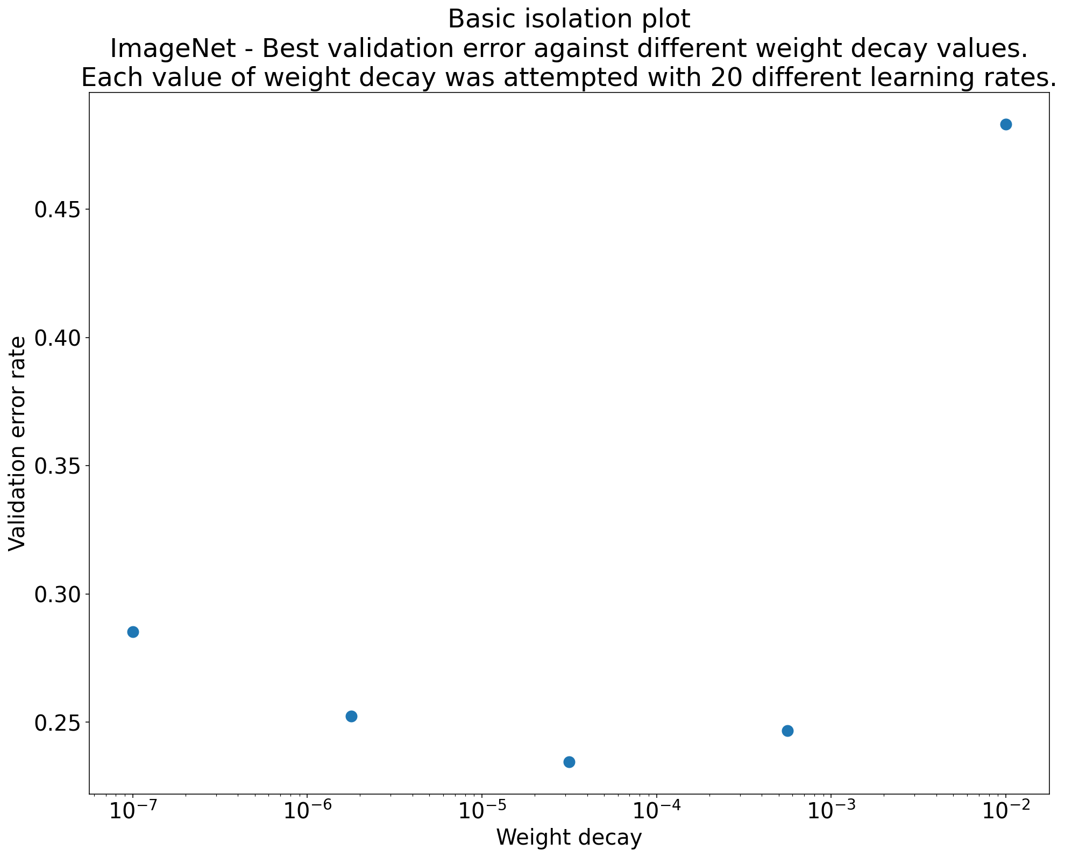
Isolation Plot: Tune the Nuisance Setting Each Time
Google Deep Learning Tuning Playbook · github.com/google-research/tuning_playbook
Each dot: the best of 20 learning rates
Papers: github.com/google-research/tuning_playbook

Slide 61
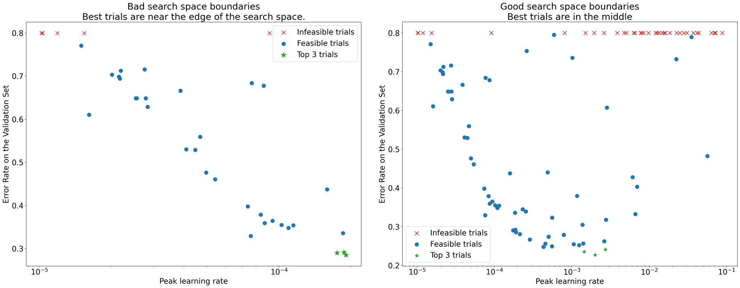
Search Space: Are Your Best Trials on the Edge?
Google Deep Learning Tuning Playbook
Best trials at the edge of the range? Widen it
Papers: github.com/google-research/tuning_playbook

Slide 62

Objectives: What the Model Is Rewarded For
Cross-entropy
Label smoothing
Contrastive
The default for classification
Softer targets; can help generalisation
Pull matching pairs together
Changing the objective is an intervention, not a detail

Slide 63

Optimisers: SGD, Adam and AdamW
SGD + momentum
Adam
AdamW
Simple, still strong for many vision tasks
Per-parameter step sizes; common for Transformers
Fixes weight decay inside Adam; today’s usual choice
Which one wins often depends on how much tuning each got
Papers: arxiv.org/abs/2007.01547

Slide 64
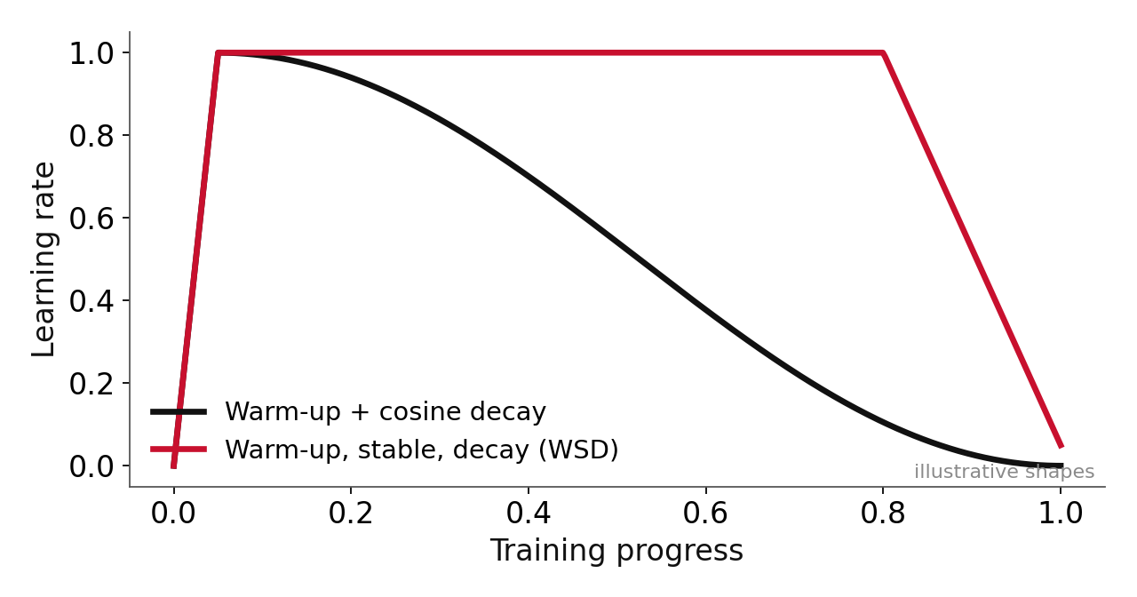
Schedules: Warm-up, Then Decay
Batch size changed? Retune the learning rate

Slide 65



Regularisation: What It Controls
Dropout
Weight decay
Augmentation
Early stopping
Switches units off
Pulls weights toward zero
New training views
Halt when validation stalls
Give baselines the same regularisation effort

Slide 66

2026 Update: Muon Joins AdamW
The claim
The plumbing
Still open
Moonshot AI reported about 2× compute efficiency over AdamW at compute-optimal training
NVIDIA reports Muon training at near-parity throughput with AdamW in Megatron
Do the gains hold at your scale, and after fine-tuning?
AdamW is no longer the only default to beat
Papers: arxiv.org/abs/2502.16982

Slide 67
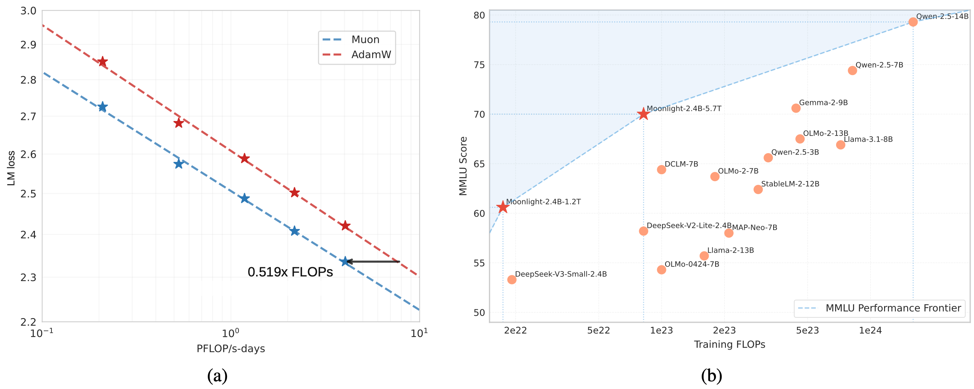
2026 Update: Muon vs AdamW in the Authors’ Plot
Liu et al., Muon Is Scalable for LLM Training · github.com/MoonshotAI/Moonlight
Muon reaches the same loss with less compute, in the authors’ runs
Papers: arxiv.org/abs/2502.16982

Slide 68
2026 Update: Training in 4-bit
The result
The catch
The lesson
NVIDIA trained a 12B model on 10 trillion tokens in NVFP4, matching an FP8 baseline
A 2026 study found selected layers still need higher precision at scale
Short ablations catch crashes, not late-emerging accuracy loss
A short experiment does not prove a long run will hold
Papers: arxiv.org/abs/2509.25149 · arxiv.org/abs/2610.24343

Slide 69
Live Paper Analysis: What Changed in ResNet Strikes Back?
Setting | Classic recipe | New recipe
Optimiser | SGD | LAMB
Loss | Cross-entropy | Binary cross-entropy
Training length | About 90 epochs | 100 to 600 epochs
Augmentation | Crop and flip | + RandAugment, Mixup, CutMix, repeated augmentation
Regularisation | Weight decay | + stochastic depth
Many settings moved together. Which one mattered?
Papers: arxiv.org/abs/2110.00476

Slide 70

What a Recipe Change Hides
They changed together
The paper has separate ablations. Without them you would ask for them.

Slide 71
Design a Tuning Plan (Activity)
ReLU vs GELU in a small Transformer. You have 40 GPU runs.
Which setting is scientific?
1
Which settings are nuisance?
2
How would you split the 40 runs?
3
Type your plan in the chat.

Slide 72
A Fair Split of 40 Runs
2 × 5 × 4 = 40
Two activations · five learning rates each · four seeds

Slide 73
MCQ 3: Fair Tuning of a Nuisance Setting
A team compares two activation functions. How should they treat the learning rate?
A
Tune it only for the new activation
B
Fix one value and use it for both
C
Tune it separately for each, with the same budget
D
Copy the value from the original paper

Slide 74
MCQ 3 — Answer
Correct answer: C
Tune it separately for each, with the same budget
Why
The learning rate is a nuisance setting. Each variant needs its own good value, found with equal effort.
Discuss: why are the other options wrong?

Slide 75
Part 5 Recap: Box for Your Brief
One line to remember
Box for your brief
The training recipe is part of the method. Give baselines the same effort.
Your training setup and your reproducibility risk
Questions next, then a break

Slide 76
Q&A Checkpoint 1
1
Type your question, starting with a Q
2
Still unclear: architectures, scaling or training?
3
Next: data, stability and evaluation
Questions now · leftovers answered in the chat during the break

Slide 77
Break 1 (10 minutes)
1
Post pending questions in the chat
2
So far: question → bets → attention → scaling → training
3
Next: data, stability, evaluation, adaptation
We resume in 10 minutes · think of one idea you could use

Slide 78

Data, Compute and Scaling Laws

Slide 79
Welcome Back: One Thing You Could Use
One idea
From the first hour, one thing you could use in your own project
Type it in the chat. A few words is enough.

Slide 80
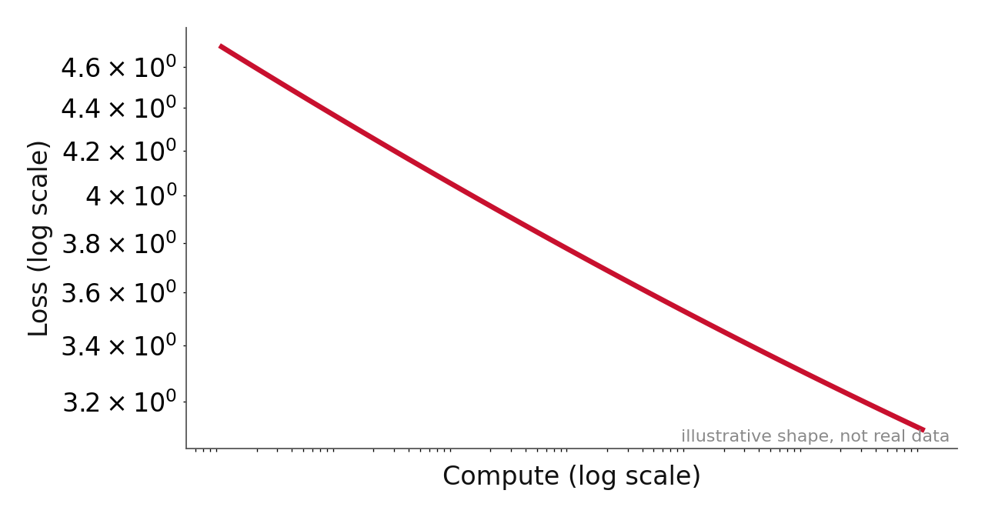
Scaling Laws: A Straight Line on a Log Plot
Loss often falls smoothly with size, data and compute
Papers: arxiv.org/abs/2001.08361

Slide 81

Chinchilla: Grow Model and Data Together
The question
The answer
The proof
For a fixed compute budget, what is the best model size and data size?
Grow both together. Roughly 20 training tokens per parameter.
Chinchilla 70B beat Gopher 280B on about 4× more data
A 100M-parameter model wants about 2B tokens
Papers: arxiv.org/abs/2203.15556

Slide 82
Back-of-the-Envelope Compute (Activity)
Training FLOPs ≈ 6 × parameters × tokens
1B parameters, 20B tokens: how many FLOPs?
1
One GPU sustains about 100 TFLOP/s. How many days?
2
What does that mean for your project?
3
Calculator out. About a minute.

Slide 83
The Answer: About 14 Days on One GPU
1.2×10²⁰ FLOPs ≈ 14 days
6 × 10⁹ × 2×10¹⁰ = 1.2×10²⁰ · ÷ 10¹⁴ per second ≈ 1.2 million seconds

Slide 84

Three Cautions About Scaling Laws
Fitted curves
Loss, not tasks
It depends on the goal
They describe the range tested, not a law of nature
They mostly predict loss, not your task score
Heavy serving demand favours smaller models trained longer
Use them as a guide, not a guarantee

Slide 85
2026 Update: Scaling Laws Learn About Inference
Train-to-Test scaling
The finding
Read
April 2026: choose model size, data and number of inference samples together
Once test-time sampling counts, overtraining small models becomes compute-optimal
Also Lilian Weng, “Scaling Laws, Carefully” (2026)
The target moved from training cost to lifetime cost
Papers: arxiv.org/abs/2604.01411 · lilianweng.github.io/posts/2026-06-24-scaling-laws/

Slide 86
2026 Update: What If You Run Out of Data?
Repeating data
Prescriptive laws
One finding
Many runs now reuse the same tokens for several epochs
A 2026 paper models repetition and overfitting explicitly
Strong weight decay reduces the overfitting penalty from repetition
Chinchilla assumed plenty of fresh data
Papers: arxiv.org/abs/2605.01640

Slide 87
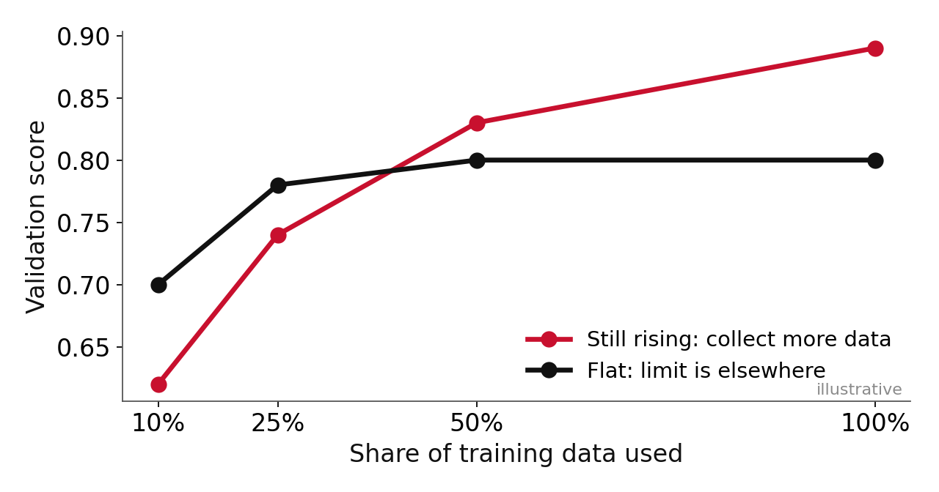
Learning Curve: Does More Data Help?
Train on 10, 25, 50, 100% of the data and plot

Slide 88


Data Quality Is Not Just Size
Duplicates
Label errors
Leakage
Mismatch
Near-copies in train and test inflate scores
About 3% in common test sets
Test data slipped into training
Training data unlike real use
Different data is a second intervention
Papers: arxiv.org/abs/2103.14749

Slide 89
Build a Fair Comparison Table (Activity)
Row to fill | Model A: large, short | Model B: small, long
Total / active parameters | ? | ?
Training tokens or steps | ? | ?
GPU hours | ≈ equal | ≈ equal
Tuning runs, seeds | ? | ?
Which rows must we fill before calling it fair?

Slide 90
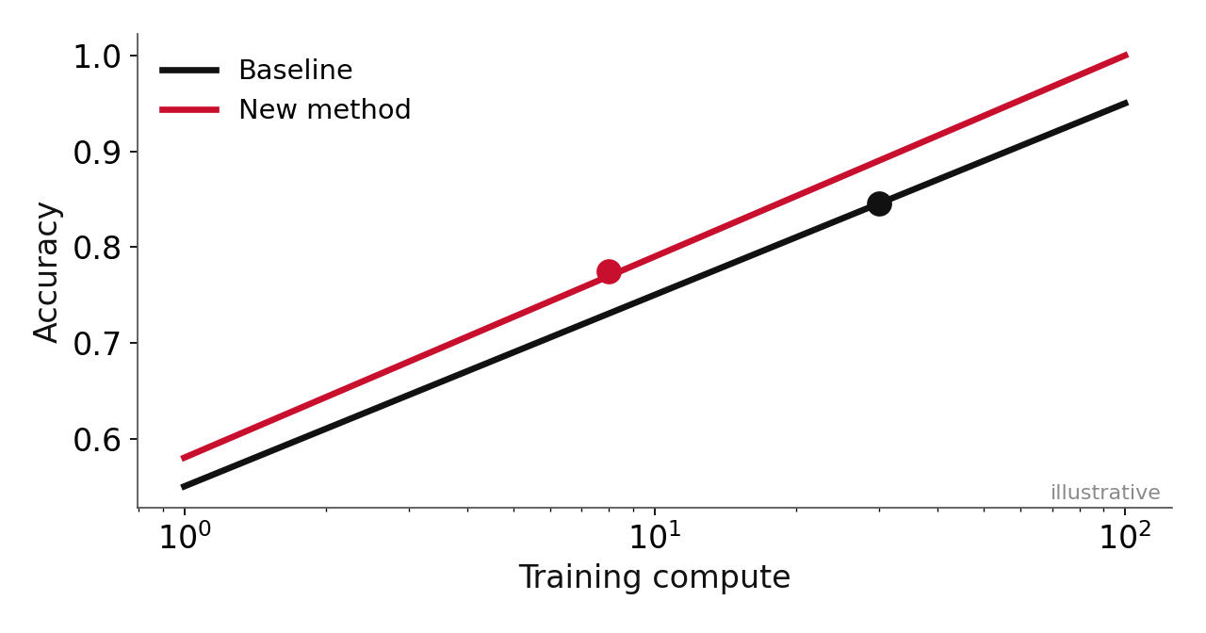
Compare Along a Compute Curve
Report a curve, not one hand-picked point

Slide 91
Takeaway: Part 6
One line to remember
Box for your brief
Compare along a compute curve with matched data
The resources you hold fixed: data, compute, tuning, seeds
Next: when training goes wrong

Slide 92

Training Stability and Diagnostic Reasoning

Slide 93
A Diagnostic Routine
Look at the data
Check the first loss
Overfit one batch
Scale up
examples, labels, shapes
about ln(classes)
loss near zero
one change at a time
Most “model problems” are data problems
Papers: karpathy.github.io/2019/04/25/recipe/

Slide 94
The First Loss Should Be About ln(C)
10 classes → about 2.3
A model that knows nothing starts near the natural log of the class count

Slide 95
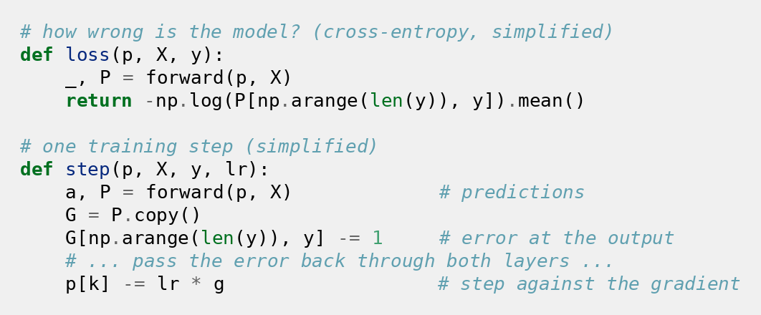
Demo Code: The Loss and One Training Step
Simplified from the full file, about 40 lines in all

Slide 96
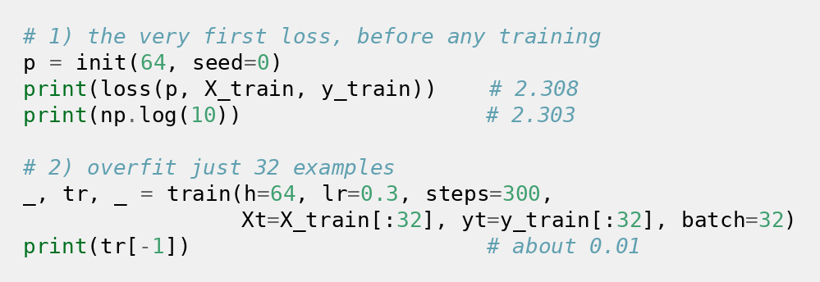
Demo Code: First Loss and One Batch
Two checks that cost seconds

Slide 97
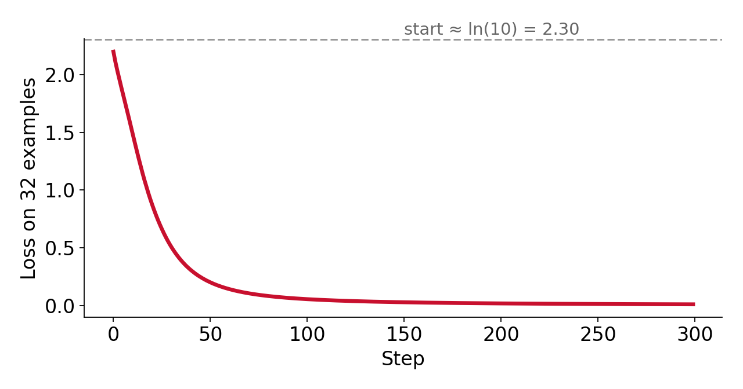
Demo Run: First Loss and One Batch
First loss ≈ 2.31 · then overfit 32 examples to ≈ 0.01

Slide 98
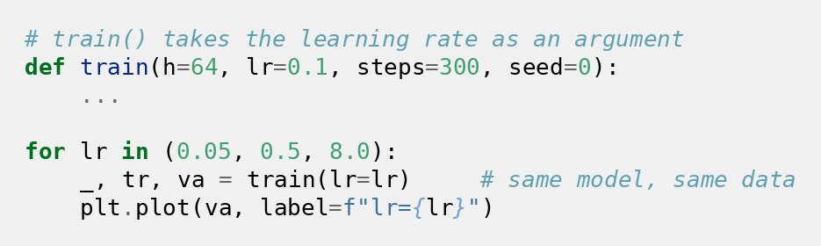
Demo Code: A Learning-Rate Sweep
Only the learning rate changes

Slide 99
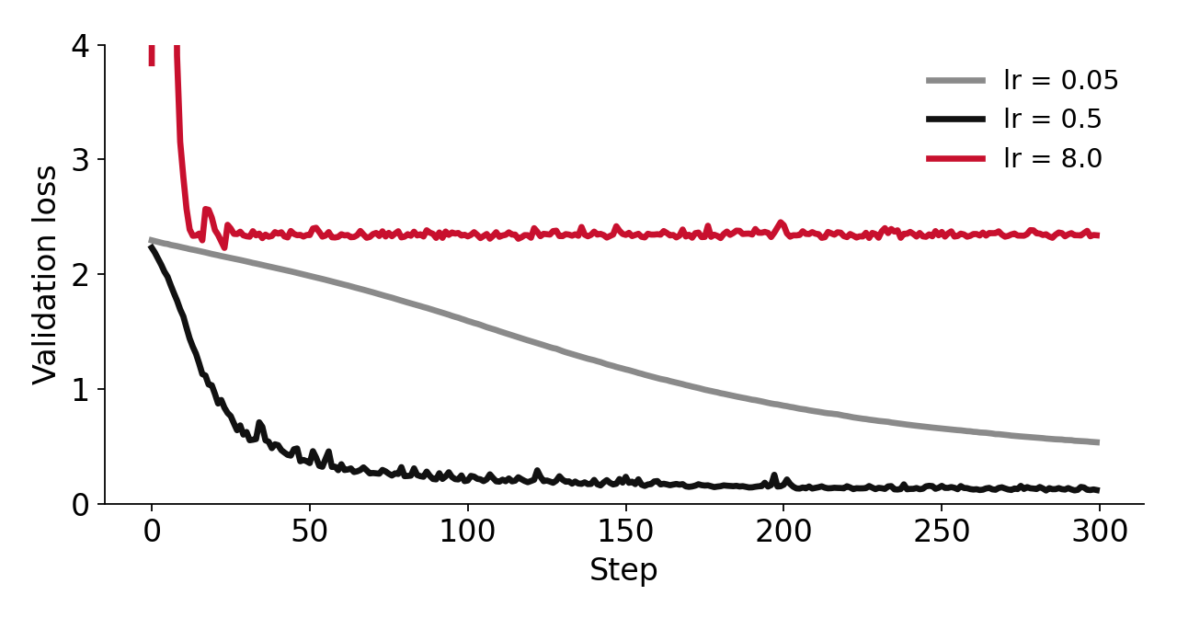
Demo Run: A Learning-Rate Sweep
Too low: slow · good: fast · too high: stuck

Slide 100
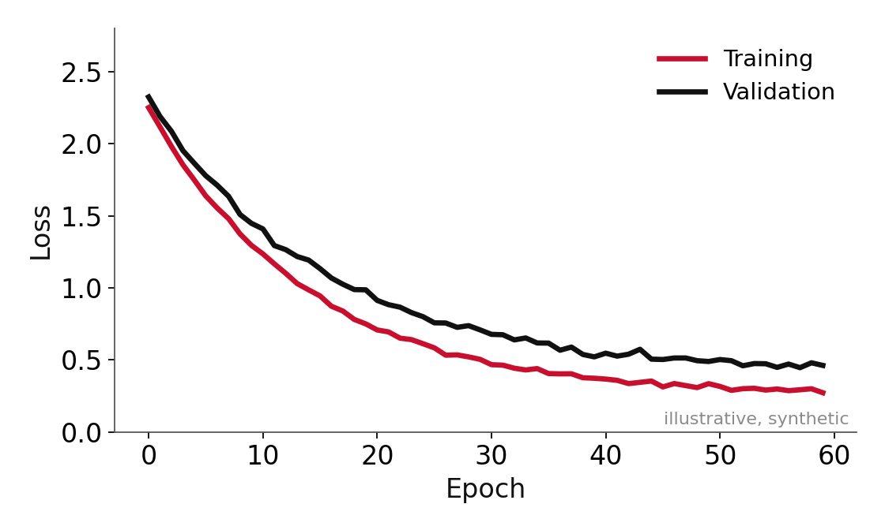
Read the Curves (Activity): Reference
Both losses fall together; the gap stays small

Slide 101
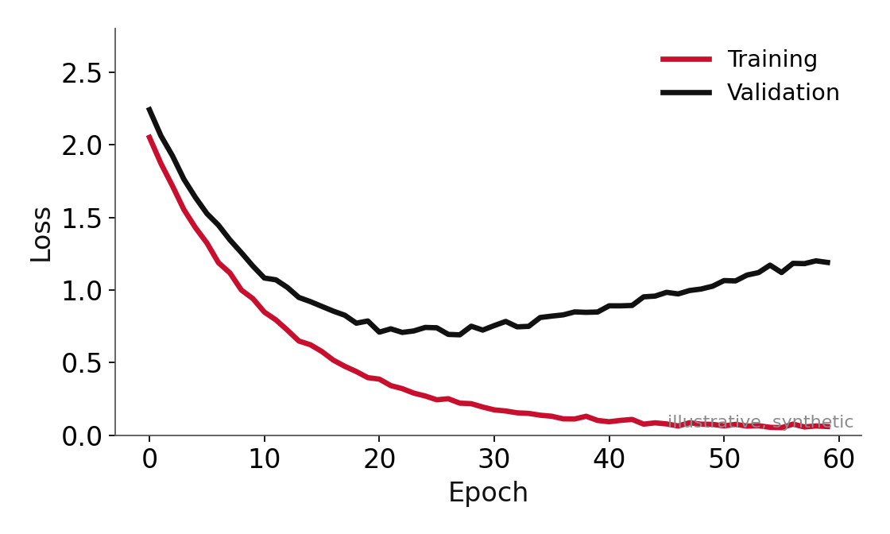
Read the Curves (Activity): Curve A
What is going on? What would you check first?

Slide 102
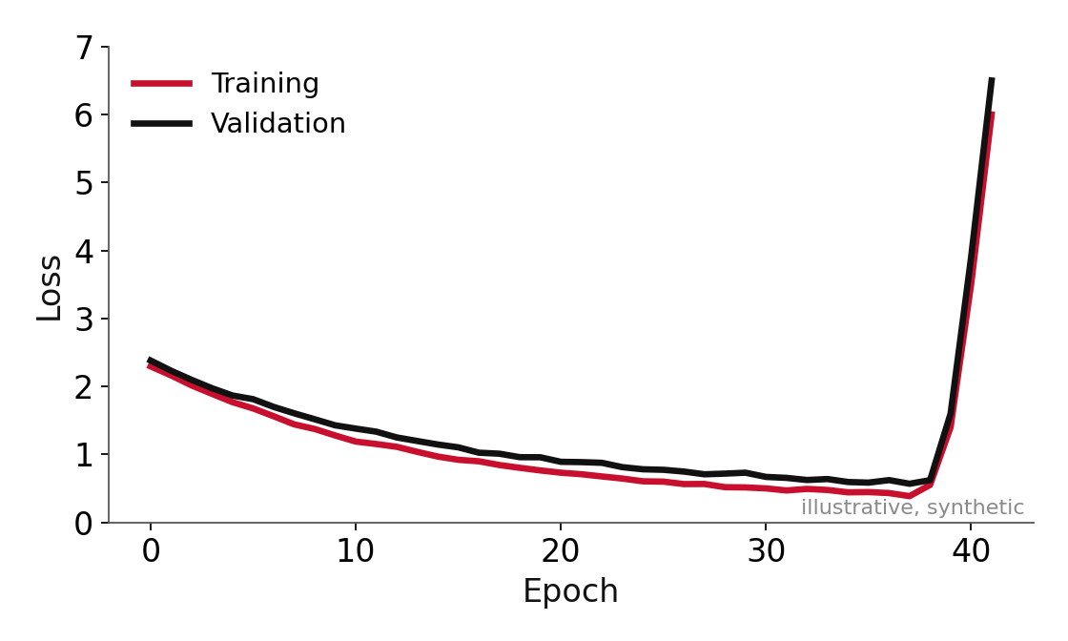
Read the Curves (Activity): Curve B
What is going on? What would you check first?

Slide 103
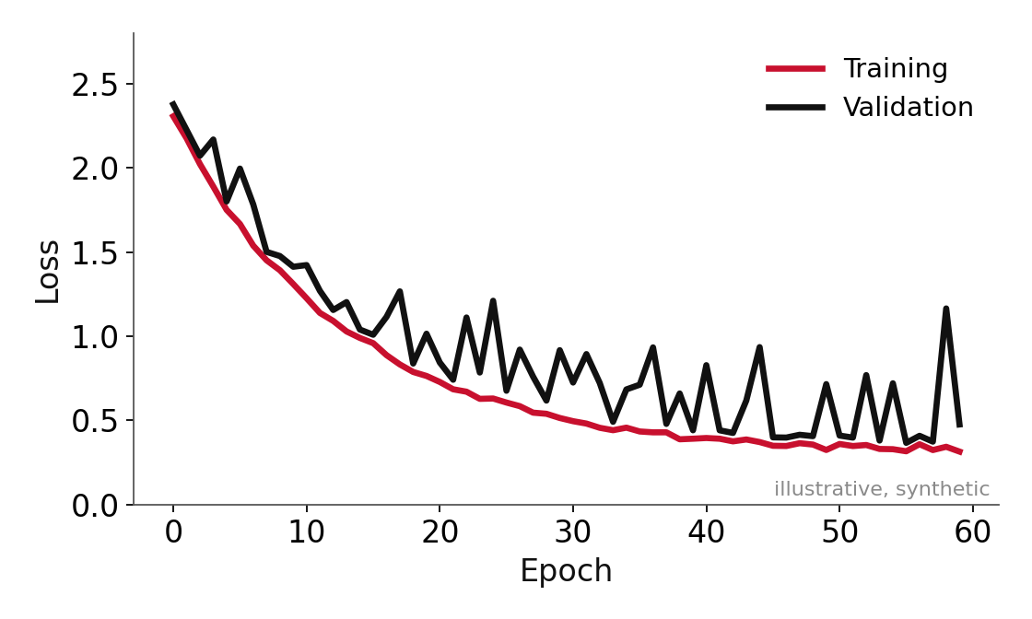
Read the Curves (Activity): Curve C
What is going on? What would you check first?

Slide 104
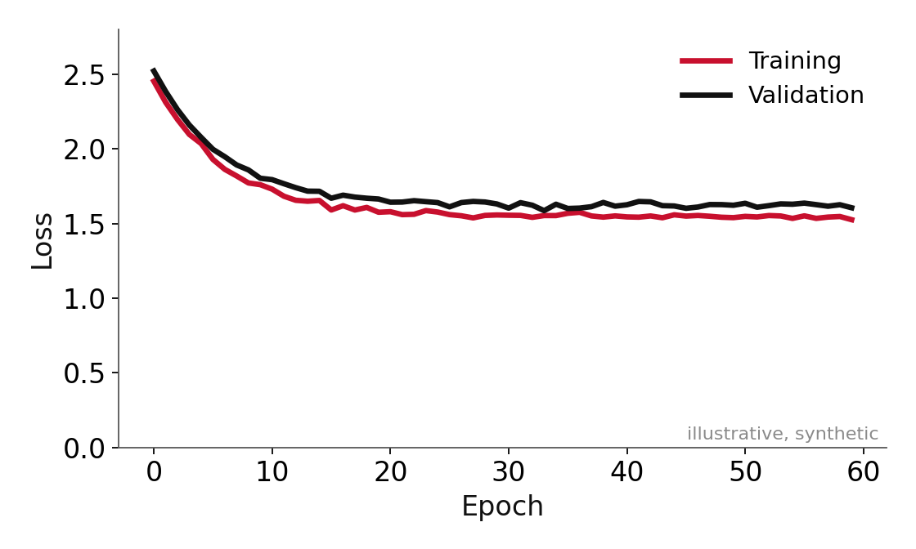
Read the Curves (Activity): Curve D
What is going on? What would you check first?

Slide 105
Read the Curves (Activity) (Answers)
Curve | Diagnosis | First checks
A | Overfitting | Early stop · regularise · more data
B | Divergence or loss spike | Gradient norm · bad batch · lower rate, clipping
C | Unstable validation | Bigger validation set · more seeds · schedule
D | Underfitting or stuck | Overfit one batch · rate · capacity
Always restart from the last good checkpoint

Slide 106

From Debugging to Evidence
Report stability
Keep records
Use checkpoints
How many runs diverged, over which learning rates
Checkpoints, configs and seeds
Compare before and after a spike
Stability is a result, not a nuisance

Slide 107
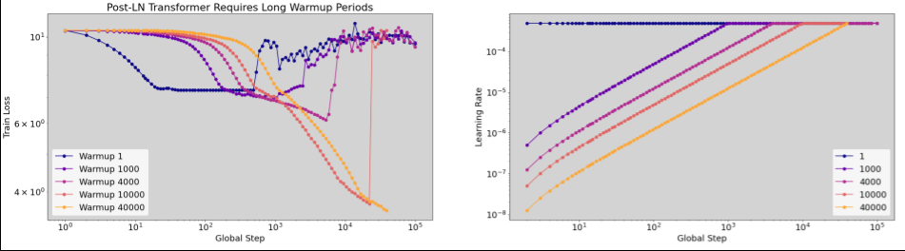
Warm-up Helps Against Early Instability
Google Deep Learning Tuning Playbook
Warm-up length changes how stable the start of training is
Papers: github.com/google-research/tuning_playbook

Slide 108
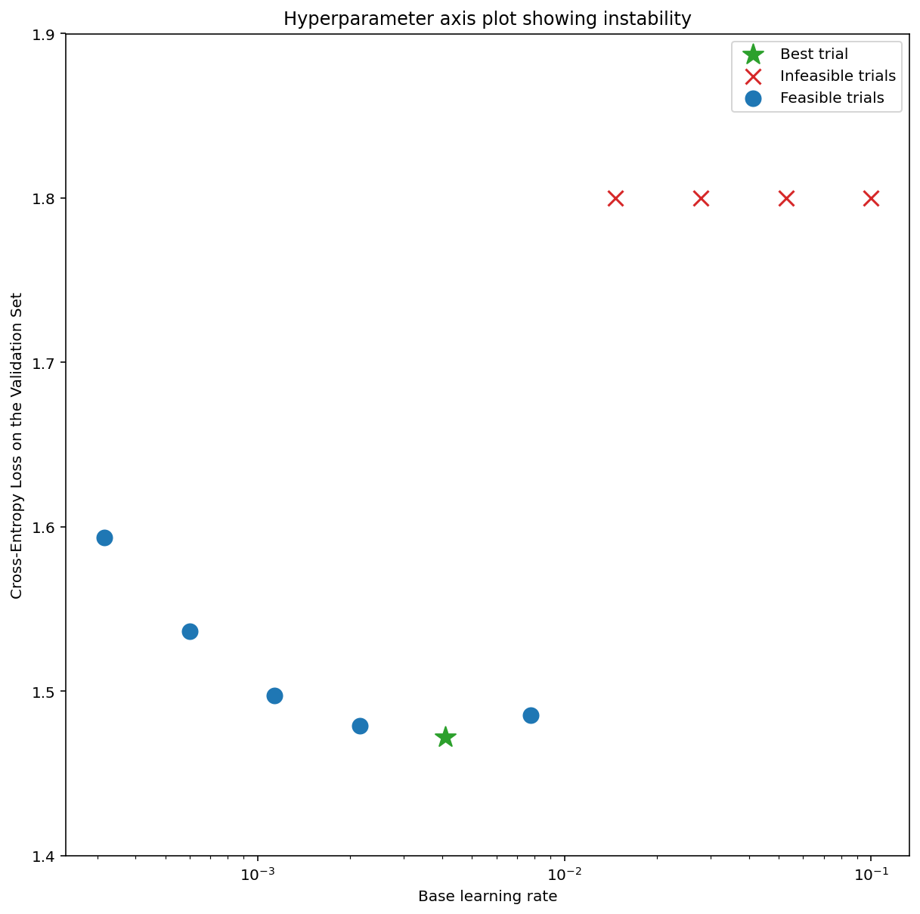
Instability Shows Up in Sweeps Too
Google Deep Learning Tuning Playbook
Red crosses: trials that diverged
Papers: github.com/google-research/tuning_playbook

Slide 109
Case: Loss Spikes in a Very Large Run
Even big labs restart
The PaLM team restarted from a checkpoint before a spike and skipped a few hundred batches
Papers: arxiv.org/abs/2204.02311

Slide 110
MCQ 4: Reading the First Loss
A ten-class classifier prints a first training loss of 40. What is most likely?
A
That is normal at the start
B
Something is broken before training begins
C
The model is overfitting
D
The learning rate is too low

Slide 111
MCQ 4 — Answer
Correct answer: B
Something is broken before training begins
Why
A model that knows nothing should start near 2.3, the natural log of ten. Look at labels, loss, inputs and scaling first.
Discuss: why are the other options wrong?

Slide 112
Part 7 Recap: Box for Your Brief
One line to remember
Box for your brief
Report stability, not only your best run
One training-stability risk and how you will detect it
Next: evaluation beyond accuracy

Slide 113

Evaluation Beyond Benchmark Accuracy

Slide 114

Four Kinds of Claims
Performance
Efficiency
Robustness
Scalability
Scores higher
Costs less
Holds up when data changes
Benefit grows with scale
Which one am I claiming?

Slide 115
Generalisation: A Fresh Test Set
−11 to −14 points
Models lost this much accuracy on a freshly collected ImageNet test set
Papers: arxiv.org/abs/1902.10811

Slide 116
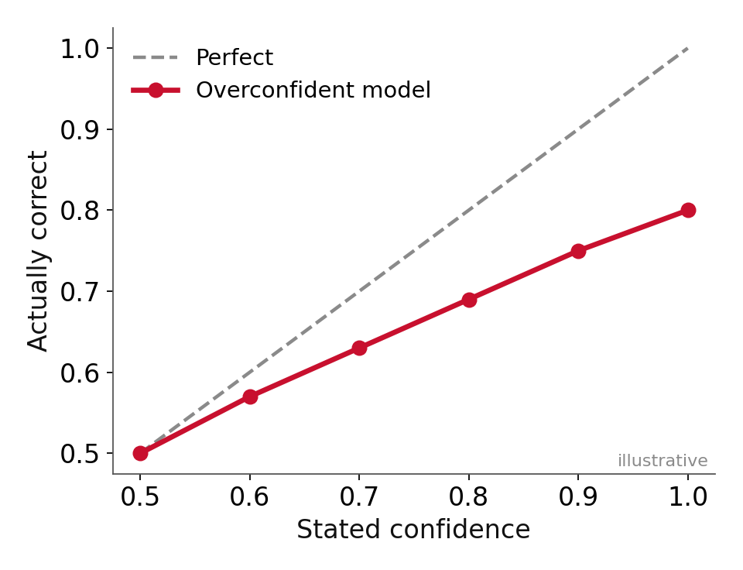
Calibration: Is 90% Really 90%?
Modern networks tend to be overconfident
Papers: arxiv.org/abs/1706.04599

Slide 117
Robustness and Efficiency
Robustness
Efficiency
Test with noise, blur, shifted data and different sources
Report parameters, compute per example, memory and latency
A tiny gain at ten times the cost is a trade-off, not a win

Slide 118
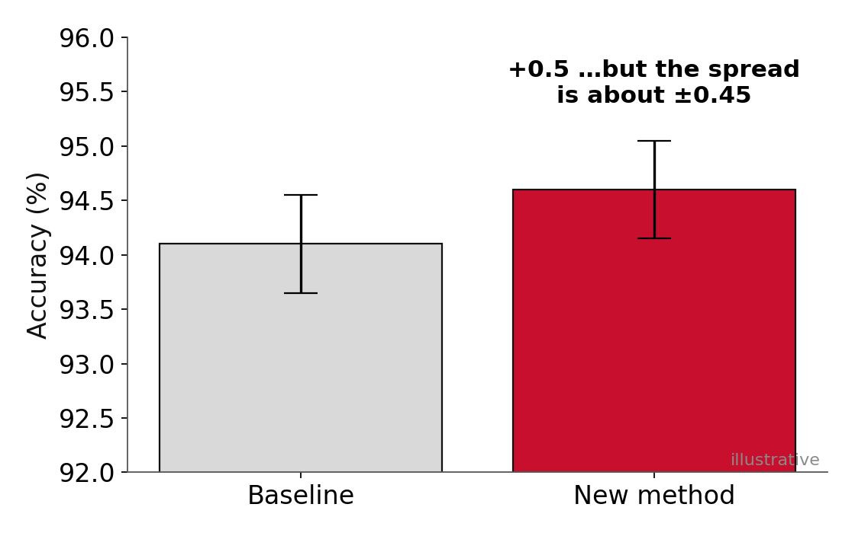
Seeds: Is +0.5 Bigger Than the Spread?
Repeat runs. Report mean and spread.

Slide 119
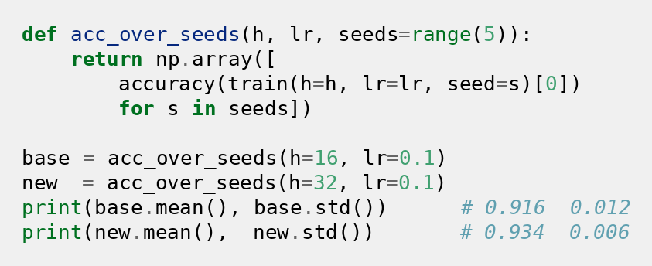
Demo Code: Five Seeds
Mean tells the typical score, spread tells the wobble

Slide 120
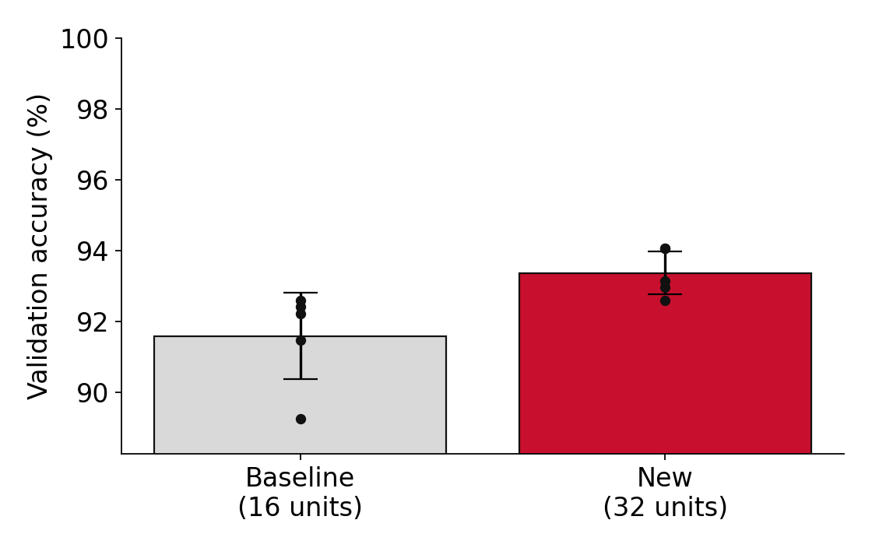
Demo Run: Five Seeds, an Honest Gap
Gap ≈ 1.8 points · spread ≈ 0.6 to 1.2 · five seeds each

Slide 121
2026 Update: Benchmarks Saturate, Single Seeds Mislead
Saturation is widespread
Seeds and splits
One run can be far off
A February 2026 study formalised it: top models cluster, so score gaps stop meaning much
Seemingly superior results can vanish when seeds or splits change
A 2026 study found single-seed estimates off by around 40% at some settings
Your habit: several seeds, fresh data, uncertainty reported
Papers: arxiv.org/abs/2602.16763 · arxiv.org/abs/2604.23114

Slide 122
Audit This Claim (Activity)
CIFAR-10: 94.1 → 94.6%, “and more efficient”
One training run per model
1
New model: 8 learning rates tried. Baseline: 1
2
Best checkpoint chosen on the test set
3
30% fewer parameters but 2× the steps
4
Be the reviewer.

Slide 123
Audit This Claim (Activity): Your Questions
Type your three questions for the authors
What is the spread across seeds?
1
Was the baseline tuned equally?
2
What data was used to pick the checkpoint?
3
What is the total training and inference cost?
4
Two minutes in the chat.

Slide 124
Audit This Claim: What a Reviewer Asks
Single run
Unequal tuning
Test-set leakage
Efficiency
Is half a point bigger than the noise?
Eight settings against one
Pick the checkpoint on validation
Fewer parameters but twice the steps
Lipton and Steinhardt: know where the gains come from
Papers: arxiv.org/abs/1807.03341

Slide 125

A 2026 Case: Leakage-Aware Evaluation Done Well
Group by patient
Five seeds
Balanced accuracy
Images from one patient never sit in both train and test
Report the spread, not one run
A metric that fits the class mix
A small 2026 medical-imaging study, a good template

Slide 126

Case Clinic: The Vendor Slide
“+4 points, 3× faster”
One benchmark, no error bars. You are the buyer.

Slide 127
Case Clinic: Your Questions to the Vendor
Type your top three questions
What would you ask about the benchmark?
1
What would you ask about the speed claim?
2
What would you test on your own data?
3
One minute in the chat.

Slide 128
Case Clinic: What a Careful Buyer Asks
Benchmark
Speed
Spread
Your data
Saturated? Contaminated? Does it match my task?
Same hardware, batch size and precision?
How many seeds? Error bars?
A pilot on my data, including shifted slices
Your own evaluation beats their slide

Slide 129
Paper to Read: When AI Benchmarks Plateau
When AI Benchmarks Plateau: A Systematic Study of Benchmark Saturation
Saturation is widespread
Top models cluster together
2026
Gains can vanish when seeds or splits change
arxiv.org/abs/2602.16763

Slide 130
Takeaway: Part 8
One line to remember
Box for your brief
Say which kind of claim you make, with evidence that fits
Your primary metric and two supporting checks
MCQ next

Slide 131
MCQ 5: What Is Missing From This Robustness Claim?
A paper says “our model is more robust” and shows accuracy on the standard test set. What is missing?
A
Nothing. High accuracy means robust
B
Results on shifted or noisy data
C
More parameters
D
A longer training run

Slide 132
MCQ 5 — Answer
Correct answer: B
Results on shifted or noisy data
Why
Robustness is about what happens when the data changes. The standard test set cannot show that.
Discuss: why are the other options wrong?

Slide 133

Efficient Adaptation: Transfer, Distillation and Parameter-Efficient Tuning

Slide 134
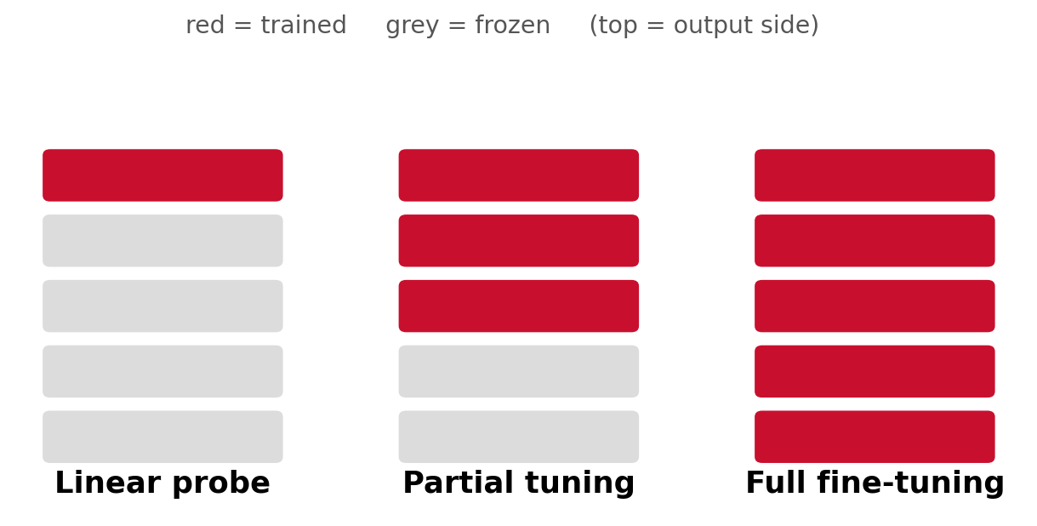
Transfer Learning in One Picture
The question: how much quality for how much less cost?

Slide 135
Forgetting: Test the Old Abilities Too
Adapted ≠ improved
A model can lose general abilities while it adapts

Slide 136

Distillation: A Small Student, a Big Teacher
Teacher
Student
A real case
A big model gives soft output probabilities
A small model learns to imitate them
DistilBERT: about 40% smaller, 60% faster, about 97% of the performance
The student is bounded by its teacher
Papers: arxiv.org/abs/1910.01108

Slide 137
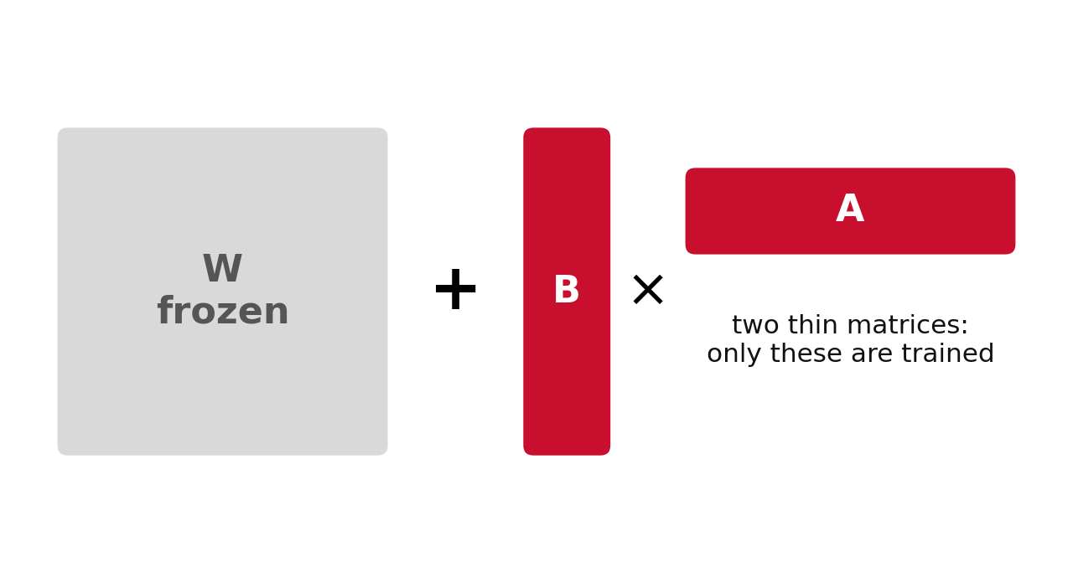
LoRA: Two Thin Matrices
Freeze W. Train only A and B.
Papers: arxiv.org/abs/2106.09685

Slide 138
Quick Math: Why LoRA Is Small
16.8M → 65.5K
One 4096×4096 weight vs a rank-8 update: 2 × 4096 × 8 parameters

Slide 139
QLoRA and the Single-GPU Story
Quantise the base
Train LoRA on top
The effect
Store the frozen model in 4-bit
Small, high-precision adapters
Very large models fine-tuned on a single GPU
Each method trades something: quality, time or complexity
Papers: arxiv.org/abs/2305.14314

Slide 140
Compare on Four Axes
Method | Compute | Memory | Data needs | Quality
Linear probe | Lowest | Lowest | Little | Drops if task is far
Full fine-tune | Highest | Highest | Enough to avoid overfit | Strongest with data
LoRA | Low | Much lower | Modest | Close on many tasks
Distillation | Teacher + student | Small at inference | A transfer set | Bounded by teacher
Compute · memory · data · quality

Slide 141
Pick the Adaptation Method (Activity)
Method + one reason
5,000 labelled examples · one 24 GB GPU · 7B model
1
Must run on a phone in 50 ms
2
5M examples · big cluster · very different domain
3
Constraints decide, not fashion.

Slide 142


Pick the Adaptation Method: What Fits
Scenario 1
Scenario 2
Scenario 3
LoRA or QLoRA: limited memory and data
Distillation, often with quantisation: inference cost is the problem
Full fine-tuning: lots of data, compute and domain shift
Constraints decide, not fashion

Slide 143

Fair Comparisons for Adaptation
Tune per method
Report together
Keep the baseline
LoRA often wants a higher learning rate
Parameters, memory, time and quality
Full fine-tune, or say why not
An adaptation claim is a trade-off

Slide 144
MCQ 6: A Fair LoRA Comparison
When is a LoRA versus full fine-tuning comparison fair?
A
When LoRA uses the default learning rate
B
When each method gets its own tuned learning rate
C
When full fine-tuning is left out
D
When only trainable parameters are reported

Slide 145
MCQ 6 — Answer
Correct answer: B
When each method gets its own tuned learning rate
Why
LoRA usually wants a higher rate than full fine-tuning, so one shared value favours one side.
Discuss: why are the other options wrong?

Slide 146
Part 9 Recap: Box for Your Brief
One line to remember
Box for your brief
An adaptation claim is a trade-off: quality together with cost
The baseline your adaptation or efficiency claim must beat
Questions next, then a break

Slide 147
Q&A Checkpoint 2
1
Type your question, starting with a Q
2
Still fuzzy: evaluation or adaptation?
3
Next: the frontier and the design lab
Questions now · leftovers answered in the chat during the break

Slide 148
Break 2 (10 minutes)
1
Post pending questions in the chat
2
So far: training → data → stability → evaluation → adaptation
3
Next: frontier scan and the design lab
We resume in 10 minutes · be ready to type

Slide 149

Frontier Scan: Emerging Deep-Learning Research Directions

Slide 150
Welcome Back: A Quick Recall
Which question?
What changed? · What was held fixed? · What would change your mind?
Which is hardest for your own idea? One word in the chat.

Slide 151
How to Read a Trend
Which limitation?
What evidence?
Smallest experiment?
What does it fix?
Published? Reproduced?
Fits my compute?
A name is not a research question

Slide 152
Direction 1: Long Sequences and Hybrids
Open question
Student-scale study
Baseline
Risk
Do hybrids match attention + retrieval on tasks that truly need long range?
Tens of millions of parameters, a long-range benchmark
Transformer with chunking or retrieval
Benchmarks that do not need long context
Evaluate: accuracy at several lengths, plus memory and time

Slide 153
Direction 2: Sparse and Conditional Compute
Open question
Study
Evaluate
Risk
When does MoE beat dense at equal training compute and active parameters?
Small MoE against a dense model, matched active parameters
Quality at matched compute, several seeds, routing balance
Expert collapse, unreported tuning
How stable is routing at small scale?

Slide 154
Direction 3: Data-Efficient and Data-Centric Training
Open question
Study
2026 angle
Risk
Is better data or selection worth more than a better model?
Deduplicate or filter, then train two architectures on both versions
Repetition under limited data, and weight decay
Filtering that removes the hard examples
Does the gain hold across architectures?

Slide 155
Direction 4: Reliable Evaluation
Open question
Study
Evaluate
Risk
How often does a published ranking survive a re-run?
Re-run two or three methods under a matched protocol
How much the ranking changes versus the original protocol
Needs original code; a mismatch is itself a finding
Great fit for working professionals

Slide 156
Direction 5: Optimisers and Low-Precision Training
Open question
Study
Evaluate
Risk
Do Muon-style optimisers and 4-bit training hold up at small scale?
AdamW vs Muon, tuned equally, small model
Loss, stability across seeds, throughput and memory
Late-emerging failures that short runs miss
The 2026 training stack is a live research area

Slide 157
Pick Your Direction
Type 1, 2, 3, 4, 5 or “own”
Long sequences and hybrids
1
Sparse and conditional compute
2
Data-centric training
3
Reliable evaluation
4
Optimisers and low precision
5
Keep your choice for the lab.

Slide 158
Feasibility Check Before You Commit
Smallest dataset + smallest model
If you cannot name them, narrow the idea until you can

Slide 159

Research Design Lab: From Frontier Idea to Testable Study

Slide 160
A Worked Study in Eight Boxes: Boxes 1 to 4
Question
Hypothesis
Dataset
Baseline
Does pre-LN allow a higher stable learning rate than post-LN?
Stable where post-LN diverges, with the same accuracy
AG News, one fixed train / validation / test split
Same model with post-LN, same learning-rate grid
Pre-LN vs post-LN: ties together parts 3, 5 and 7

Slide 161
A Worked Study in Eight Boxes: Boxes 5 to 8
Intervention
Ablation
Compute budget
Evaluation
Only the position of the layer norm
With and without warm-up
About 20 runs, 2 hours on one GPU, 5 seeds
Accuracy · max stable rate · divergence rate · test set once
Risks: loss spikes · unequal tuning or peeking at the test set

Slide 162
Your Turn: Question and Hypothesis
Boxes 1 and 2 · use the direction you picked
Question: task, limitation, one change, evidence
1
Hypothesis: a sentence that can fail
2
One line each. About two minutes.

Slide 163
Your Turn: Dataset and Baseline
Boxes 3 and 4
Dataset: smallest one that can answer the question
1
Baseline: the strongest fair comparison, equally tuned
2
Ask: would a reviewer call this fair?

Slide 164
Your Turn: Intervention and Ablation
Boxes 5 and 6
Intervention: exactly one change
1
Ablation: which part must be necessary, and why?
2
Ablation = a question, not a checklist.

Slide 165
Your Turn: Compute and Evaluation
Boxes 7 and 8
Compute: runs × seeds × hours on your GPU
1
Evaluation: primary metric + two supporting checks
2
Is it realistic for one GPU?

Slide 166
Your Turn: Name Your Risks
Two risks, one line each
A training-stability risk
1
A reproducibility or validity risk
2
These go into your brief.

Slide 167
Swap and Review
One change?
Fair baseline?
Realistic budget?
Is the intervention a single change?
Equally tuned?
Fits one GPU?
A study you can run beats an idea you can only describe

Slide 168
Swap and Review: Volunteers
Read your question and baseline
Two or three volunteers. Quick feedback on one change, fair baseline, budget.

Slide 169
Part 11 Recap: Box for Your Brief
One line to remember
Box for your brief
A study you can run beats an idea you can only describe
The eight boxes. This is the core of your brief.
Last part: roadmap and decision

Slide 170

Research Roadmap, Evidence Gate and Q&A

Slide 171
Evidence Gate: Proceed, Redesign or Park
Proceed
Redesign
Park
Clear question, data, baseline and compute
Weak baseline, compute out of reach, wrong evaluation
No data, gain cannot be isolated, not affordable now
Parking is not failing. It saves time.

Slide 172
Evidence Gate: A Quick Case
Type P (proceed), R (redesign) or K (park)
A student wants to show a new attention variant “improves translation”
1
They have a laptop GPU and no baseline implemented
2
They plan to compare with numbers copied from a paper
3
Decide.

Slide 173

Feasibility Check
Data and compute
Complexity and cost
Safeguards and gaps
Is the data accessible? Does the budget fit?
How hard is the implementation? What does evaluation cost?
Reproducibility safeguards, and the evidence still needed
Do this before training starts

Slide 174
Your Research Brief: What to Submit
Study
Evidence
Decision
Question · hypothesis · dataset · baseline · intervention
Compute · ablation · metric + two checks · two risks
200–250-word gap statement · 5+ sources · proceed, redesign or park
Every item was built in today’s session

Slide 175

From Today to Your Brief
Parts 1 to 3
Parts 4 to 6
Parts 7 and 8
Parts 9 to 11
question, intervention, ablation
compute, training setup, data
risks, metric, checks
baseline, direction, eight boxes
Nothing in the brief is new. You built it today.

Slide 176
Your Next Steps: Before You Code
Literature
Data check
Baseline first
A short search to find the gap
Is the dataset accessible?
Implement the baseline before anything fancy
Start small and honest

Slide 177
Your Next Steps: Before You Run
Compute and seeds
Evidence gaps
Supervisor
Plan them, with reproducibility safeguards
List what you still cannot answer
Take your boxes with two or three specific questions
Not “is this okay?” but “is this baseline strong enough?”

Slide 178
Five Questions Your Supervisor Will Ask
Baseline tuned?
What held fixed?
How many seeds?
What does failure look like?
Compute you have?
Prepare these five answers

Slide 179
Reading List 1: Foundations
Attention Is All You Need
Deep Residual Learning for Image Recognition
Vaswani et al. · 2017
He, Zhang, Ren, Sun · 2015
arxiv.org/abs/1706.03762
arxiv.org/abs/1512.03385
An Image Is Worth 16x16 Words (Vision Transformer)
A ConvNet for the 2020s
Dosovitskiy et al. · 2020
Liu et al. · 2022
arxiv.org/abs/2010.11929
arxiv.org/abs/2201.03545
A Recipe for Training Neural Networks
Deep Learning Tuning Playbook
Andrej Karpathy · 2019
Godbole et al. (Google Research) ·
karpathy.github.io/2019/04/25/recipe/
github.com/google-research/tuning_playbook

Slide 180
Reading List 2: Training, Scaling and Adaptation
ResNet Strikes Back: An Improved Training Procedure in timm
Training Compute-Optimal Large Language Models (Chinchilla)
Wightman, Touvron, Jégou · 2021
Hoffmann et al. · 2022
arxiv.org/abs/2110.00476
arxiv.org/abs/2203.15556
Scaling Laws for Neural Language Models
LoRA: Low-Rank Adaptation of Large Language Models
Kaplan et al. · 2020
Hu et al. · 2021
arxiv.org/abs/2001.08361
arxiv.org/abs/2106.09685
QLoRA: Efficient Finetuning of Quantized LLMs
Muon Is Scalable for LLM Training
Dettmers et al. · 2023
Liu et al. (Moonshot AI) · 2025
arxiv.org/abs/2305.14314
arxiv.org/abs/2502.16982

Slide 181
Reading List 3: Evaluation and 2026 Work
Troubling Trends in Machine Learning Scholarship
Do ImageNet Classifiers Generalize to ImageNet?
Lipton and Steinhardt · 2018
Recht et al. · 2019
arxiv.org/abs/1807.03341
arxiv.org/abs/1902.10811
When AI Benchmarks Plateau: A Systematic Study of Benchmark Saturation
Priming: Hybrid State Space Models From Pre-trained Transformers
2026
2026
arxiv.org/abs/2602.16763
arxiv.org/abs/2605.08301
Test-Time Scaling Makes Overtraining Compute-Optimal
What Matters for NVFP4 Training? A Comparative Study of Low-Precision Pretrai…
2026
Agrusa, Panferov et al. · 2026
arxiv.org/abs/2604.01411
arxiv.org/abs/2610.24343

Slide 182
Reading List 4: More Reading
Prescriptive Scaling Laws for Data Constrained Training
A Tale of Two Variances: When Single-Seed Benchmarks Fail in Bayesian Deep Le…
2026
2026
arxiv.org/abs/2605.01640
arxiv.org/abs/2604.23114
Scaling Laws, Carefully
LLM Research Papers: The 2026 List (January to May)
Lilian Weng · 2026
Sebastian Raschka · 2026
lilianweng.github.io/posts/2026-06-24-scaling-laws/
magazine.sebastianraschka.com/p/llm-research-papers-2026-part1
Pretraining Large Language Models with NVFP4
PaLM: Scaling Language Modeling with Pathways
NVIDIA · 2025
Chowdhery et al. · 2022
arxiv.org/abs/2509.25149
arxiv.org/abs/2204.02311

Slide 183
Final Q&A
1
Type your question in the chat
2
Hardest box to fill for your idea?
3
Longer discussion → the forum
Slides and notes will be shared after the session

Slide 184
One Thing You Will Change
I’ll change my…
Finish the sentence in the chat
One line. Thank you.

Slide 185
Thank You!

